Slide 1
Security of Retirement Benefits in Canada

Slide 2
What’s your game?

Slide 3
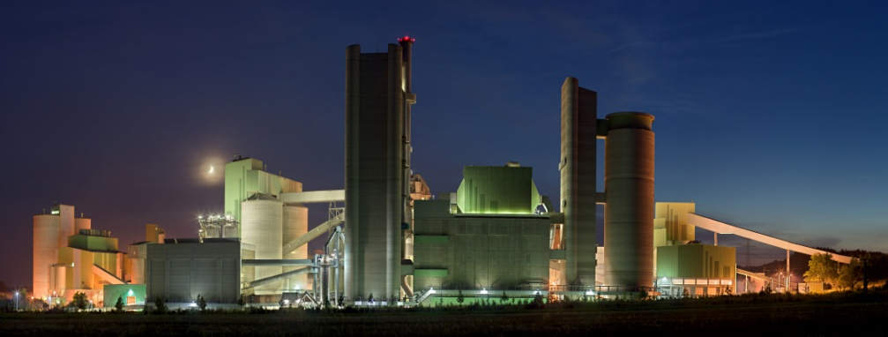
Why employers back the game
Industrialization
Farm to factory
End of family enterprise
Counter-unionization
Human face
Benefit tied to keeping your job.
Rationalization
Pyramid organization
Retain skilled workers
Exit for less productive

Slide 4
The stakes
Non-pension benefits
Pensions
Life insurance
Age factor in premiums
Extended health
Utilization increase with age
Dental
Age not as big a factor
Defined contribution
Promise to pay fixed amount into account while working
Pension based on amount in account on retirement,
employee takes risk may be inadequate
Defined benefit
Promise to pay amount for life on retirement
If funding inadequate employer to make up difference

Slide 5
The House: Non-pension Benefits
Non-unionized employment
Unionized employment
Employment Law
Employer may terminate without cause
Must provide “reasonable notice” of termination
Termination without notice = “wrongful dismissal”
Damages = compensation for lack of notice
Employer unilateral changes only constrained by willingness to terminate, if employee objects
Collective bargaining law
Employer may not terminate without “just cause”
Unjust dismissal may = reinstatement + compensation for lost wages
Employer obliged to negotiate changes in terms of employment with union

Slide 6
The Bet: Legal Status Non-pension
Non-unionized
Unionized
Risks
Termination before vesting
Vesting within notice period
Unilateral change – active
Defiance or termination
Unilateral change – retired
Ill-defined rights
Interpretation as contingent or subject to amendment
If vested - employer solvency.
Risks
“Just cause” protection
Can satisfy vesting conditions
Changes must be bargained
Active -retirement benefits dependent on bargaining power
Retirees – can union bargain to reduce benefits for retirees?
Access to remedy if union won’t take grievance

Slide 7
The House: Pension Benefits
Same statutory protection - union/non-union
No retroactive benefit reductions
Prospective reduction/termination permitted
Only security against this same as for non-pension benefits
Short period vesting
Claim not extinguished by termination

Slide 8
The Odds: Legal Status
Non-pension
Non-union
Non-pension
Union
Pension
Both union and non-union

Slide 9
All Bets Are Off: Insolvency
Constitutional Factors
Insolvency: federal; Employment: provincial
Federal paramountcy – conflict or undermining purpose
Factors affecting the odds
Priority of claims in a liquidation
Union or non-union
Type of benefit
Presence of separate fund

Slide 10
Liquidation: Non-pension benefits
No possibility of successor rights claim
Sale of assets by trustee and distribution
Governed by scheme of priorities in BIA
Some protection for active employee wages up to $2,000 – secured charge
Retiree benefits unsecured charge – share what’s left
Liquidation same whether union or non-union
Zero security
Exception – funds set aside for future costs
Must be in third party custody – trust, insurance, etc.

Slide 11
Liquidation: Pension Benefits
Plan termination
No further benefits
Accrued benefits secured by pension fund
Funded by employer/employee contributions as benefits accrued
Held by third party – employer’s creditors denied access
Security dependent on adequate funding
If not adequate pension law requires employer pay difference
Insolvency law - payments to pension fund unsecured
except the arrears for normal cost of benefits

Slide 12
Liquidation: Constitutional Craps – Dice Are Loaded
Pension law provisions intended to increase priority in insolvency rejected by courts
Deemed trust, lien and charge.
Courts concerned about provincial property and civil rights legislation altering federal priorities in insolvency
Insistence that only real trusts be recognized
Interpretation of secured charge to restrict one created in pension legislation

Slide 13
Restructuring: A New Deck
Goal – continue the business in some form
Generates more value for creditors than piecemeal liquidation
Employer remains in ostensible control
Court - stay of all proceedings against employer
Cease making payments for pension shortfall or non-pension benefits
Rationale – pre-insolvency debts – can’t pay some before others
Federal authorization for court to make order - paramountcy
provincial legislation of no force and effect if impair federal objectives

Slide 14
Restructuring: Active Employees Get An Ace
Can require immediate payment for services
Can’t be required to work for less than collective agreement rates
Continued payment for their pension costs as benefits accrued [but not for any pre-insolvency shortfall]
Not applicable for payment falling due after insolvency for pre-insolvency service

Slide 15
Restructuring: Non-union Employees Get Trumped
Non-union
Union
Insolvency statutes
Authorize disclaimer of contracts
Enhance prospects for restructuring
No significant financial hardship to other party
Other party gets provable claim dealt with in final plan
Not applicable to pension benefits
Vesting & separate funding
Insolvency statutes
Exempt collective agreement from disclaimer regime
Union must agree to any amendments
Pension benefits protected by vesting & separate funding

Slide 16
Exit: Playing the cards you’ve been dealt
Retirees have little to “trade” in restructuring
Contrast active employees
If retiree benefits in collective agreement –advantage
Could also be rolled into separate trust
Employer obligations fixed to defined contributions
Pension benefits – compromise
Lengthen time to pay shortfall [from 5 – 10 years]
Now being offered to employers outside of insolvency
Risks to security increased with length of extension

Slide 17
Insolvency: Not a “Friendly” Game
Non-union
Non-pension
Union
Non-pension
Pensions
Funding
Disclaimer
Compromise of retiree benefits
Extensions of time to pay

Slide 18
Facing the Odds
Pension benefits
Recognize that there are “known unknowns”
Clearly assign the risks of miscalculation
Price [contributions] affects degree of risk
Non-pension benefits
Adopt the pension fund pre-funding/vesting model
Consistent with accounting treatment
The “known unknowns” are different
Assign the risks based on price [contributions]

Slide 19
Security?
Arbitrary basis
Union v. non-union
Pension v. non-pension
Disconnected from the essence of the promise
Work today – benefits tomorrow
Should be recognized as deferred wages
Similar treatment should be mandated.
Better to pay for benefits as they are earned
Unfair to lay the burden on next generation

