Slide 1
Population Aging: Demographic Tsunami, or Apocalypse No ?
life expectancy, health-adjusted life expectancy, health inequality
conventional body count demo-doom
looking at workers
broader pension adequacy projections
health care – who is in control; who even understands what is happening?
Michael Wolfson, uOttawa

Slide 2
Speech from the Throne, June 3, 2011
“Canada’s workforce is aging, and it will no longer grow as it has in the past. This demographic challenge will impact our economic future and put long-term pressures on our pension and health systems that must be addressed. (p3) … Canadians want better results from the health care system, at the same time as an aging population is putting unprecedented pressure on the system’s ability to deliver. (p8)”
Notes:
Let me start with general context; difficult to imagine having a clearer indication of the relevance and importance of ourPAHRNet proposal
n.b. for our U.S. colleagues, SFT is like State of the Union (not sure re France)

Slide 3
Life Expectancy in Canada and Trends (years, 2006-2008)
 | Men | Women
Life Expectancy at Birth | 78.5 | 83.1
recent increase per decade | 2.9 | 1.8
Life Expectancy at Age 65 - Years | 18.3 | 21.5
Life Expectancy at Age 65 - Age | 83.3 | 86.5
recent increase per decade | 2.0 | 1.0
Source: Statistics Canada

Slide 4
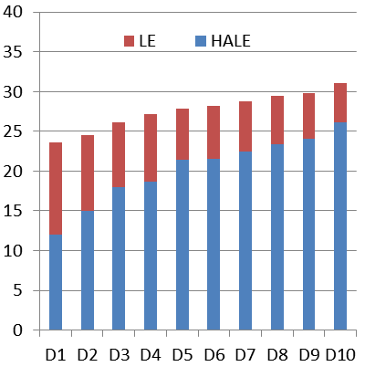
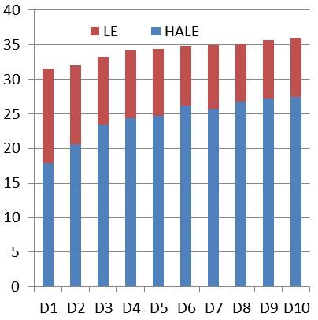
Life Expectancy (LE) and Health-Adjusted Life Expectancy (HALE) by Income Decile (years – 50, ~2000)
Men
Women
Source: McIntosh et al., 2009

Slide 5
Alternate Views of the “Aging Burden” (LifePaths estimates)
1
Notes:
let’s look at these scary stats over time within Canada, using the old age demographic ratio – shown on the bottom left in these graphs – in this case the ratio of the 65+ population to the total population (n.b. not 60+ as in first UN graph above)
here it looks almost to triple from 1971 to 2031, when trailing edge of baby boom hits age 65, and almost double from today to 2031 when it reaches about 23%

Slide 6
Alternate Views of the “Aging Burden” (LifePaths estimates)
2
1
Notes:
things are not quite as dramatic, though, if we look at the total demographic ratio – 65+ and under age 18 combined, rising less than half as much from today to 2031
though it is important to note that most of the “costs” of those under 18 are borne by families, while for those age 65+ the government plays a much larger role

Slide 7
Working Life Table Results, Canada
Notes:
But many people of working age are not actually working, while some of those age 65+ are – so it is more realistic to think of “dependency” in terms of those who are working versus those who are not, rather than in terms of the crude proxy, those who are of “working age” or not
This “working life table” was published over 30 years ago (Gnanaskaren and Montigny, building in turn on Ostry and Denton). The focus in this case is on the average ages at three major life transitions – from school to work, from work to retirement, and finally death.
The message conveyed is very dramatic – we see over a 50 year period a doubling of years spent in retirement, accompanied by a decline in working years-- with obvious implications for the “affordability” of public pensions.
(Note that these are PERIOD estimates.)

Slide 8
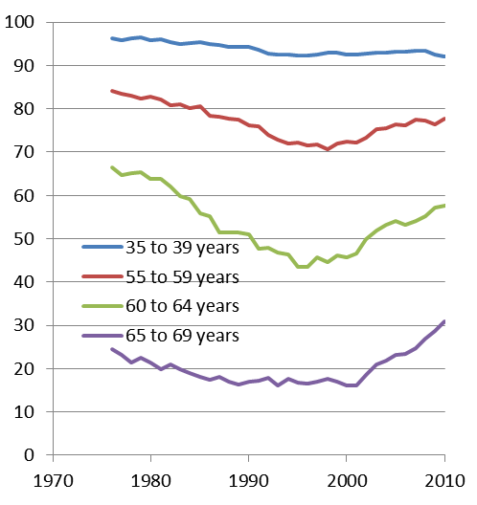
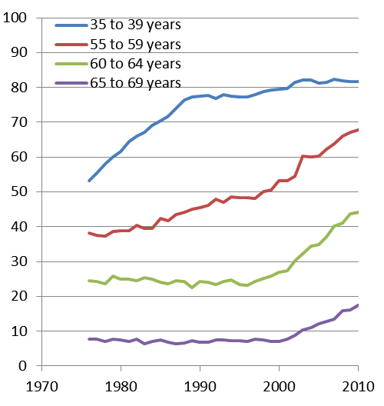
Recent Trends in Labour Force Participation Rates (%)
males
females

Slide 9
Alternate Views of the “Aging Burden” (LifePaths estimates)
3
2
1
Notes:
but “years” of work is a rather coarse granularity – since some individuals work part-year, others part-time, and yet others over-time
this graph shows an even more appropriate index – hours of paid work (at whatever age) per capita
unlike the scary stat that the old age demographic ratio is almost doubling to ~23%, the per capita paid hours measure is projected to fall by considerably less than 10 percentage points
source: LifePaths (Statistics Canada), using assumptions developed by the Interdepartmental Working Group on Population Aging and Life-Course Flexibility; published in “Population Aging and Life-Course Flexibility: The Pivotal Role of Increased Choice in The Retirement Decision”, Policy Research Initiative, Discussion Paper, March 2004

Slide 10
National Labour Supply Per Capita (~2000)
Notes:
Here we combine the data for the most recent period in the last graph with the corresponding emp / pop ratios
Canada, at 867, is more than one-third again higher than a number of rich EU countries – Italy, Belgium, France and Germany

Slide 11
Alternate Views of the “Aging Burden” (LifePaths estimates)
3
2
4
1
Notes:
And if we flip back to the previous chart, it is not clear that the projected changes in hours per capita need be of concern – while we can expect a drop of under 10 percentage points in paid hours per capita, this will still leave Canada as much as one-thrid higher that rich EU countries today, that already have conventional demographic dependency ratios ~25% -- they seem to be coping

Slide 12
Demo Doom: Really?
Canada’s old age demographic ratio is projected to approach < 25% by 2031, when the trailing edge of the baby boom cohort reaches age 65
but a number of rich EU countries already have old age demographic ratios ~25%
and using a more relevant measure, paid hours per capita, Canada’s level
  is projected to fall by less than 10%
  and will remain about 30% higher than a number of wealthy EU countries that today already have 25% old age demographic ratios
Notes:
to recapitulate …

Slide 13
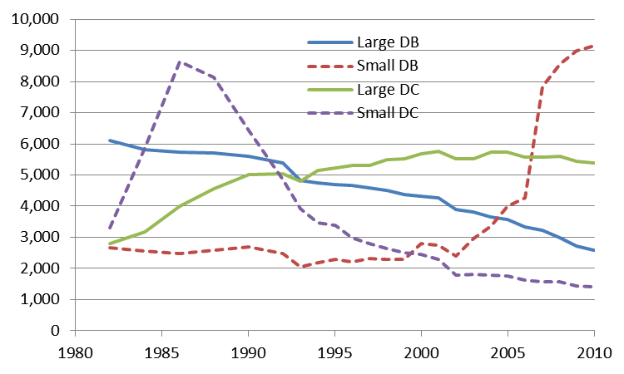
Trends in Workplace Pension Plans (RPPs), Numbers by Type and Size
(small ≡ members <10)
(tax planning?)

Slide 14
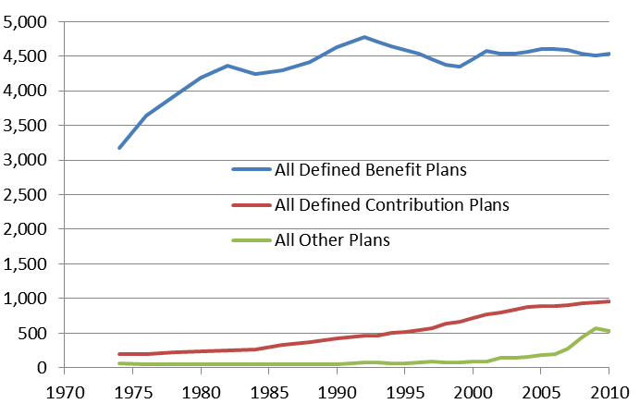
Trends in Workplace Pension Plan (RPPs) Members (000s) by Type
members (000s)

Slide 15
Criteria for an Adequate Retirement Income System
avoid poverty / “low income”
support continuity of consumption / maintenance of living standards into retirement
provide “safe” pensions = reduce uncertainty (or at least share risks fairly amongst individuals, employers, fellow employees, taxpayers)
Notes:
there are three major criteria; will focus only on the second in my comments today

Slide 16
What is the “Net Replacement Rate” (RR)?
ratio of post-retirement “consumption possibilities” to those prior to retirement
norm or objective: 100%; i.e. ability and likelihood of maintaining pre-retirement living standards after retirement
“consumption possibilities” ≡ gross income less income and payroll taxes less savings plus dis-saving (i.e. running down assets)

Slide 17
Comments on “Net Consumption Replacement Rate (RR)”
not the same as “gross income RR” or “net income RR”
income RRs are easier to estimate and analyze, but not as close to the desired concept of “consumption possibilities”
next slide shows basic accounting
Notes:
note that the “net RR” concept in this analysis is similar to that used in other recent analyses, including Mintz (2009), Horner (2009), LaRochelle-Côté, Myles and Picot (2008) and Ostrovsky and Schellenberg (2009)
but considerably more sophisticated than that used in many more popular discussions

Slide 18
Replacement Rate (RR) Adequacy – Basic Accounting
 | Pre-Retirement | Post Retirement
add | earnings | public pensions
 |  | RPP, RRSP and RRIF “income”
 | imputed rent on owned home | imputed rent on owned home
 |  | net withdrawals of home equity
subtract | income and payroll taxes | income taxes
 | RPP and RRSP contributions
 | mortgage principal payments
divide | EAU (= equivalence scale) | EAU (= equivalence scale)
result | “consumption” pre-retirement | “consumption” post-retirement
not included: work-related expenses, other investments (income, saving, dis-saving), consumer durables, business assets, inheritances and gifts inter-vivos
Notes:
here is the basic accounting
n.b. Horner (2009) included work-related expenses at 3%
Mintz (2009) based on Horner (2009), and LaRochelle-Côté et al both included the same equivalence scale adjustment
Mintz / Horner include imputed rent, but not any net withdrawals of home equity
LaRochelle-Côté et al and Mintz / Horner include “other investments” – i.e. non-registered financial savings like bank accounts, mutual funds and GICs; work is underway to add these to the LifePaths model, and to assess the impact of their exclusion in the analysis so far; LaRochelle-Côté et al show, in Table 4, that these sources of income average about 11 – 12% of total income at ages 69 to 77 for the middle income quintile; but for this same income quintile (see Table 8), for those experiencing at least a 20 percentage point drop in their income replacement rate, investment income and capital gains accounted for between 5 and 7 percent of total income; we return to these figures later in judging the impact of the omission of non-registered financial savings on our overall simulation results below

Slide 19
Prime Age (40 – “65”) Earnings
percent indiv’s
~ 50%
19 - 27%
19 - 26%
earnings age 40 – “65” $000s
Notes:
given this discussion of the def’n of net RRs, it is important to emphasize that they characteristically vary considerably by pre-retirement earnings
this graph shows the estimated distribution of “prime age” (i.e. 40 to “65”) earnings in 2010 $ (using AW discounting) for the 1960 – 65 birth cohort
I’ll be focusing comments on the ~50% in the middle of the distn – from $35 to 80 k
n.b. earnings age 40 – “65”: age 65 is in quotes because actually the last year considered in computing each individual’s prime age earnings is their last year of earnings, but not less than age 60 (years prior to age 60 with nil earnings are included in the average as zeros) and not more than age 65 (i.e. earnings after age 65 are ignored in this “prime age earnings” average)
n.b. in this and the following slides, average prime age earnings are also divided by the EAU (equivalent adult unit) scale, year by year, appropriate to each individual’s simulated family circumstances in each year

Slide 20
Average Net Replacement Rates by Prime Age Earnings – Main Result (1960-65 cohort)
%
~ 50%
earnings age 40 – “65” $000s
Notes:
and (finally) here is the main result – assuming representative distributions of home ownership etc.

Slide 21
Basic Conclusion
about half of the “baby boom” population (those born between 1945 and 1970)
in the middle 50% of the earnings distribution for their prime working age years (i.e. age 40 to 65)
can expect a decline in their net replacement rate (RR) / consumption possibilities after retirement
of at least one-quarter

Slide 22
PBO Data on Health Care Costs
(PBO FST p16)
Notes:
let me turn now to some cost projections
starting with this graph from the Parliamentary Budget Office’s 2010 Fiscal Sustainability Report
here is their unadorned graph

Slide 23
PBO Data on Health Care Costs
(PBO FST p16)
Aging
Notes:
the public discussion, as well as the commentary in the PBO report itself, focus on the trend highlighted by the curved line I’ve added – very scary

Slide 24
PBO Data on Health Care Costs
(PBO FST p16)
“population and health care enrichment will put significant pressure on … health spending” (PBO FST p20)
Notes:
but PBO spent much less time discussing the much more steeply sloping straight lines I’ve added shown here
these lines show the growth in per capita costs within each 5 year age group, and these over only a 9 year period, not the decades involved in the very slow tsunami of popl’n aging

Slide 25
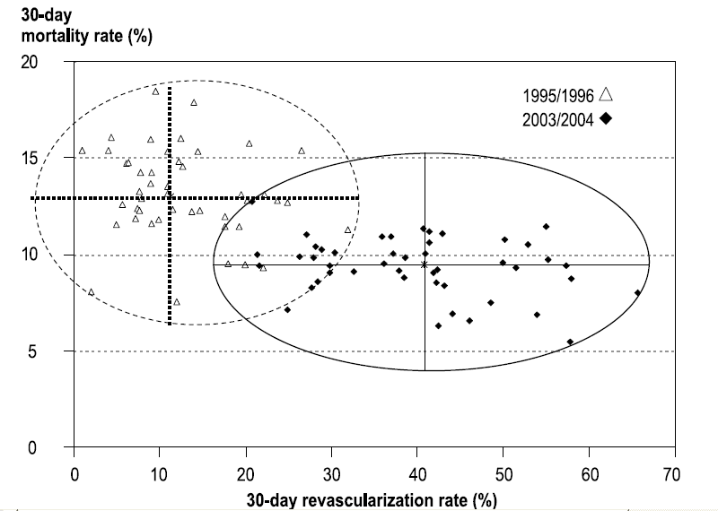
Heart Attack Survival in Relation to Treatment by Health Region, Seven Provinces
Johansen et al., 2009
Notes:
Each dot in this graph represents one large health region (population over 100,000)
-- with the region’s revascularization rate for AMI cases plotted along the horizontal axis, and its 30 day mortality rate along the vertical axis. (n.b. vertical axis scale twice as large as horz axis scale visually…)
The hollow triangles show the situation in 1995/6, while the black diamonds are 8 years later.
Overall, there has been a dramatic increase in treatment rates – more than a tripling from an average of 12.8 to 39.8%. We might therefore expect a similarly dramatic improvement in outcomes. And we do see some improvement in survival, but compared to the increase in treatments, the reduction in mortality is more modest, about a 3.6 percentage point drop – from 13.2 to 9.4%.
http://www.statcan.gc.ca/pub/82-003-x/2009002/article/10872-eng.pdf

Slide 26
Heart Attack Survival in Relation to Treatment by Health Region, Seven Provinces
Johansen et al., 2009
Notes:
Even more importantly, the scatter of dots shows a very wide variation among health regions. In 2003/4, a number of health regions had 30 day mortality rates around 8-10%, yet treatment rates varied about three-fold, from around 20% to about 60%.
Most importantly, the impression given by this graph is first that health care practice is all over the place. To put it starkly (and notwithstanding various clinical trials arguing for the efficacy of rapid revasc for AMI cases), why should a health region do 3 times as many procedures if there is no observable difference in mortality outcomes?
n.b. CMMS on the compare hospitals web site (http://www.hospitalcompare.hhs.gov/staticpages/for-professionals/poc/Technical-Appendix.aspx#POC3) assume that PCI within 90 minutes of arrival with an AMI should be universal (!)
see also the hierarchical regression approach for 30 day mortality: http://www.hospitalcompare.hhs.gov/staticpages/for-professionals/ooc/statistcal-methods.aspx
and risk adjustment covariates: http://www.hospitalcompare.hhs.gov/staticpages/for-professionals/ooc/risk-adjustments-and-covariates.aspx

Slide 27
Heart Attack Survival in Relation to Treatment by Health Region, Seven Provinces
Johansen et al., 2009
Notes:
Even more importantly, the scatter of dots shows a very wide variation among health regions. In 2003/4, a number of health regions had 30 day mortality rates around 8-10%, yet treatment rates varied about three-fold, from around 20% to about 60%.
Most importantly, the impression given by this graph is first that health care practice is all over the place. To put it starkly (and notwithstanding various clinical trials arguing for the efficacy of rapid revasc for AMI cases), why should a health region do 3 times as many procedures if there is no observable difference in mortality outcomes?
n.b. CMMS on the compare hospitals web site (http://www.hospitalcompare.hhs.gov/staticpages/for-professionals/poc/Technical-Appendix.aspx#POC3) assume that PCI within 90 minutes of arrival with an AMI should be universal (!)
see also the hierarchical regression approach for 30 day mortality: http://www.hospitalcompare.hhs.gov/staticpages/for-professionals/ooc/statistcal-methods.aspx
and risk adjustment covariates: http://www.hospitalcompare.hhs.gov/staticpages/for-professionals/ooc/risk-adjustments-and-covariates.aspx

Slide 28
Important Caveats for the AMI → Revascularization → Mortality Results
other clinical aspects of treatment not taken into account, e.g. thrombolysis, post discharge Rx
no risk factors considered – e.g. obesity, physical fitness, smoking, hypertension, lipids
no socio-economic factors considered
n.b. in related analysis, co-morbidity (Charlson Index) was included, with one-year (versus 30 day) mortality follow-up – results essentially unchanged
revascularization is also intended to relieve symptoms, but no health-related quality of life (HRQoL) data available
Notes:
Of course, there are some important caveats, and herein lie many challenges.
No account has been taken of other clinical factors – e.g. extent and speed of thrombolysis, or conventional risk factors like hypertension, obesity and smoking status. Nor have we taken any account of the broader determinants of health.
Also, the intended benefits of revascularization are much more than a reduction in 30 day mortality. Revascularization after AMI is also intended to improve quality of life, especially reduction of anginal pain, as well as improve longer term survival. [n.b. have also done one year mortality follow-up, and included adjustments for co-morbidity for subset of prov’s; the results were essentially unchanged. ] But the key problem is that the data are just not there.
Even with these caveats, these results are unsettling. There is a great deal of clamour in Canada that the health care sector is short of money. What any economist will immediately wonder, on seeing this graph of wide variations across health regions, is whether the system is suffering from major inefficiencies. How can some health regions do one-third as many bypass and angioplasty procedures as others, yet have the same 30 day mortality rates?

Slide 29

“Wall of Ignorance”
Notes:
In Canada, we still have far too much of what we see in this photo, what Dennis Psutka (a former Ont ADM) 20 years ago called the “wall of ignorance”. My neighbour, a GP, took this photo of his office only a few years ago.
Please do not get me wrong. From the viewpoint of one doctor, and his or her patient relationships, these kinds of paper records have been sufficient for decades. But beyond local one-on-one encounters, this way of storing information is useless.

Slide 30
Concluding Comments
demography – challenges, yes; doom, not
  count of seniors – will double
  trend in “economic dependency” – manageable
workplace pension plans (RPPs) – big changes not (yet) visible in current data, though trends emerging
retirement income adequacy – for middle 50% of baby boomers, about half will face at least 25% NET decline
health care – major issues
  costs not under control or even well understood
  “wading in waste” (CEO, Saskatoon) / “30% unnecessary” (CEO Ottawa Hospital) / “doing the right thing right” - not
  information systems still in dark ages (privacy chill, medical associations, Infoway et al., where are you?)

