Slide 1
REGULATING STRIKES IN (MORE OR LESS)
ESSENTIAL SERVICES AFTER THE
“COLLECTIVE BARGAINING TRILOGY”
Bernie Adell, Faculty of Law, Queen’s University
bernard.adell@queensu.ca

Slide 2

by Bernie Adell, Michel Grant and Allen Ponak,
Queen’s IRC Press, 2001

Slide 3
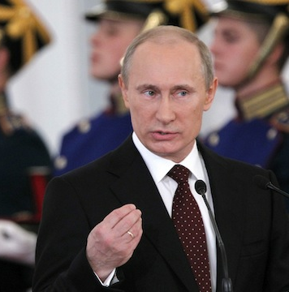
Part 1: The policymaker's question
If a government in Canada didn’t have to worry about constitutional constraints, what model of strike regulation should it adopt?

Slide 4
TWO COMPETING PERSPECTIVES ON
LABOUR DISPUTE RESOLUTION
1. Perspective of power
    Labour disputes should be resolved through the interplay of economic power, or sometimes, through political power.
2. Perspective of principle
    It’s more civilized to resolve disputes through the application of rational criteria by independent adjudicators.

Slide 5
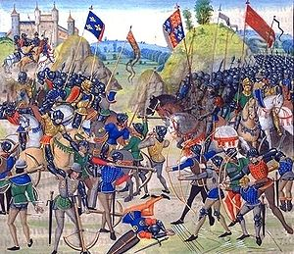
“…medieval trial by battle…”

Slide 6
THERE’S BEEN A LONG-TERM MOVE
FROM POWER TO PRINCIPLE IN OUR FIELD
19th century – simple reliance on the strike threat
1907 to the 1980s – strike threat was limited by compulsory conciliation, certification, compulsory grievance arbitration, etc.
Since the 1980s: Ever-growing role of legislated equality rights, Charter litigation, and third-party adjudication in essential service disputes (designation process, interest arbitration)

Slide 7
THE THREE (classic) REGULATORY MODELS FOR ESSENTIAL SERVICES
1. Unfettered strike model
2. Designation model (or controlled strike model)
3. No-strike model

Slide 8
1. UNFETTERED STRIKE MODEL
Still prevails in most of the private sector – but no longer in most of the public sector, including health care.
Except in Nova Scotia, where the end may be near in health care.
A power-based model: relies on interplay of economic power, then maybe on ad hoc use of political power through back-to-work legislation.

Slide 9
UNFETTERED STRIKE MODEL:
ADVANTAGES
Focuses bargaining on key issues.
Gives parties a sense of ownership of settlement terms.
High rate of voluntary settlement in low-essentiality sectors.

Slide 10
UNFETTERED STRIKE MODEL: DISADVANTAGES
Unions have the power to decide unilaterally what services to maintain – and don’t always use it responsibly.
In “high-impatience” sectors, the unfettered strike model often morphs into a fourth model…

Slide 11

THE "INSTANT BACK-TO-WORK" MODEL
Toronto Public Transit Service Resumption Act, 2008 . . .
. . . The continuation of these disputes and the resulting disruption of transit services give rise to serious public safety, environmental, health, and economic consequences for residents of the City of Toronto. …… Having regard to these serious concerns and the clear deadlock in negotiations, the public interest requires an exceptional and temporary solution to address the matters in dispute . . .
Therefore, Her Majesty, by and with the advice and consent of the Legislative Assembly of the Province of Ontario, enacts as follows . . . .

Slide 12
2. DESIGNATION MODEL
(or CONTROLLED STRIKE MODEL)
Combines power-based and principle-based elements (work stoppages, adjudication of designations).
Has steadily become more popular across Canada.
  - Used in all sectors in BC and under Canada Labour Code
  - Used in parts of public and parapublic sectors in Ontario, Quebec, NB, NL, MB.

Slide 13
DESIGNATION MODEL: ADVANTAGES
Generally (but not always) adequate maintenance of essential services.
Fairly high likelihood of negotiated settlements.
Sort of middle-of-the road (stereotypically Canadian).

Slide 14
DESIGNATION MODEL: DISADVANTAGES
  Designation process is cumbersome– but seems to work more smoothly in later rounds.
  Unions see it as inevitably reducing their bargaining power – may be tempted to use disruptive tactics while performing essential services.
  As with the unfettered strike model -- increased public impatience with strikes means it sometimes morphs into the Instant-Back-to-Work model . . .

Slide 15
Or now, under the
Canada Labour Code, into something even more frantic -

Slide 16
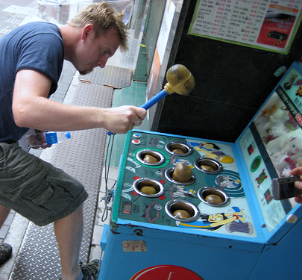
THE WHACKAMOLE MODEL
Canada Post
Air Canada
CP Rail . . .

Slide 17
3. NO-STRIKE MODEL
  Prohibits strikes, and purports to provide a principled way to settle collective bargaining disputes.
  Alberta is the heartland for this model - hospitals, civil service
  Poster child for the no-strike model: the Ontario hospitals (HLDAA)

Slide 18
NO-STRIKE MODEL: ADVANTAGES
Best protection for essential services, if the law is respected (which it usually is in most Canadian jurisdictions).
No cumbersome designation procedure.
Arbitrators have been adept at sidestepping government interference.
No pretence of an (illusory) right to strike in high-impatience sectors – avoids Instant-Back-to-Work and Whackamole models.

Slide 19
NO-STRIKE MODEL: DISADVANTAGES
Arbitrators are “conservative” – they can’t afford to alienate either side.
Governments can try to rig the arbitration process, to save money or facilitate restructuring.
“Chilling effect” on bargaining may mean too many issues are passed on to the arbitrator.
Arbitrators continually struggle with the “market replication” vs. “fairness” dilemma.
Defiance may involve a clear affront to the rule of law.
Conflict may surface in other forms, including grievances.

Slide 20
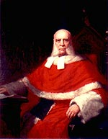
Part 2: The lawyer's question --–
What are the constitutional constraints on doing what might be best in policy terms?

Slide 21
The “collective bargaining trilogy” 2001-2007-2011
A month after our book came out – we suddenly got a constitutional right to collective bargaining (sort of) in Dunmore – followed (sort of) by BC Health and Fraser – the "collective bargaining trilogy."
None of the models discussed above was tested in the trilogy. In all three cases, the SCC said it wasn't asked to decide whether there’s a constitutional right to strike.
Among academics, there’s a virtual consensus that the Court will find such a right.

Slide 22
But will the heavy lifting be done under s.2(d) or under s.1?
Will a restriction on strikes have to substantially impair the right to strike in order to breach freedom of association under section 2(d)? [The “keep it in s. 2(d)” approach]
  This would mean that the complainants will have the onus of proving substantial impairment.
Or will any restriction on strikes be held to be a breach of s.2(d), and need to be justified under s.1? [The "everything to s. 1" approach]
  This would mean that the gov’t will have the onus of proving justification under the Oakes test.
Academics are split on this question.
  For example, Brian Etherington and Kevin Banks argue for the first approach; Jamie Cameron and Brian Langille argue for the second.

Slide 23
Saskatchewan Federation of Labour case – Justice Ball – Feb. 2012
So far, this is the only post-Fraser decision on whether there is a protected right to strike – it says yes.
Deals with a very bowdlerized form of the designation model, which gives employers ultimate power to designate essential services unilaterally.
Ball J. takes the "everything to s. 1" approach.
But he explicitly leaves a lot of room for finding that a genuinely independent alternative to the strike will be justifiable under the Oakes test.

Slide 24
My (tentative) view on the s.2(d) versus s.1 question
The key legal question may be this one:
  Does the right to strike flow directly from freedom of association, or does it flow from the right to collective bargaining which the trilogy finds to be a part of freedom of association?
If the right to strike flows from the right to collective bargaining, a no-strike or designation model with a genuinely independent form of dispute resolution could readily be held not to breach freedom of association.
This would leave somewhat more scope for legislative policymaking than the "everything to s. 1" approach.
In a functioning democracy like ours, more scope for legislative policymaking is generally a good thing.

